Slide 1
Third-Party Risk Assessment for VLC Media Player

Slide 2
1. Introduction
One of the most popular free and open-source multimedia players is VLC. However, it has flaws that bad actors could take advantage of, just like any other software. This report evaluates the risks to third parties posed by VLC, identifies critical flaws and possible ways of exploitation, and offers suggestions for reducing such risks.

Slide 3
2. Understanding Third-Party Risks
When flaws in software components, libraries, or dependencies result in security gaps, third-party risks are created. These vulnerabilities could be used by attackers to carry out denial-of-service (DoS) attacks, run remote code, or obtain unauthorized access to user systems in the case of VLC.

Slide 4
3. Key Vulnerabilities in VLC
We have identified three critical vulnerabilities in VLC based on data from the National Vulnerability Database (NVD), CVE Details, and VLC Security Advisory.

Slide 5
Vulnerability : CVE-2023-5678 - Buffer Overflow Attack
Description: An attacker can exploit a buffer overflow in VLC to execute arbitrary code.
Exploitation Technique: Specially crafted network streams or media files overflow memory buffers, leading to system compromise.
Impact: Unauthorized system control, memory corruption, and potential data loss.

Slide 6
4. Exploitation Techniques
Malicious File Execution: Attackers distribute corrupted media files via email or malicious websites.
Network Streaming Attack: Attackers send malicious packets through VLC’s streaming feature to exploit vulnerabilities.
Buffer Overflow Exploits: Sending oversized media metadata can cause memory corruption, leading to system crashes or unauthorized access.

Slide 7
5. Steps to Create a Third-Party Risk
To better understand third-party risks, follow these steps to create and simulate a risk scenario:
Identify the Software Components: List all third-party dependencies and libraries used by VLC.
Analyze Known Vulnerabilities: Check databases like NVD and CVE Details for reported security flaws.
Develop an Exploit Test Case: Create a file or payload that triggers a vulnerability (e.g., a malicious MKV file).
Execute the Test Case: Run the test file in a controlled environment to observe its impact.
Document the Findings: Record the vulnerability details, exploitation technique, and observed behavior.

Slide 8
6. How to Run the Exploit Test
To simulate a vulnerability test, follow these steps:
Step 1: Create the Malicious File
Use the following Python script to generate a potentially harmful MKV file:
with open("malicious.mkv", "wb") as f: f.write(b"\x1A\x45\xDF\xA3") # EBML Header (Fake MKV) f.write(b"\xFF\xFF\xFF\xFF\xFF\xFF\xFF\xFF") # Invalid data to crash VLC print("Malicious MKV file created: malicious.mkv")

Slide 9
Step 2: How to Save a File
Open a Text Editor:
You can use Notepad, VS Code, or PyCharm in Windows.
Write the Code:
Type or copy the given code into the editor.
Save the File:
In Notepad, click File → Save As.
Enter the file name: crash_vlc.py
Select Save as type: All Files (.)
Set Encoding: UTF-8
Choose a Location:
Save the file on Desktop or in *C:\Users\Aamir*
Now this file is ready to use

Slide 10
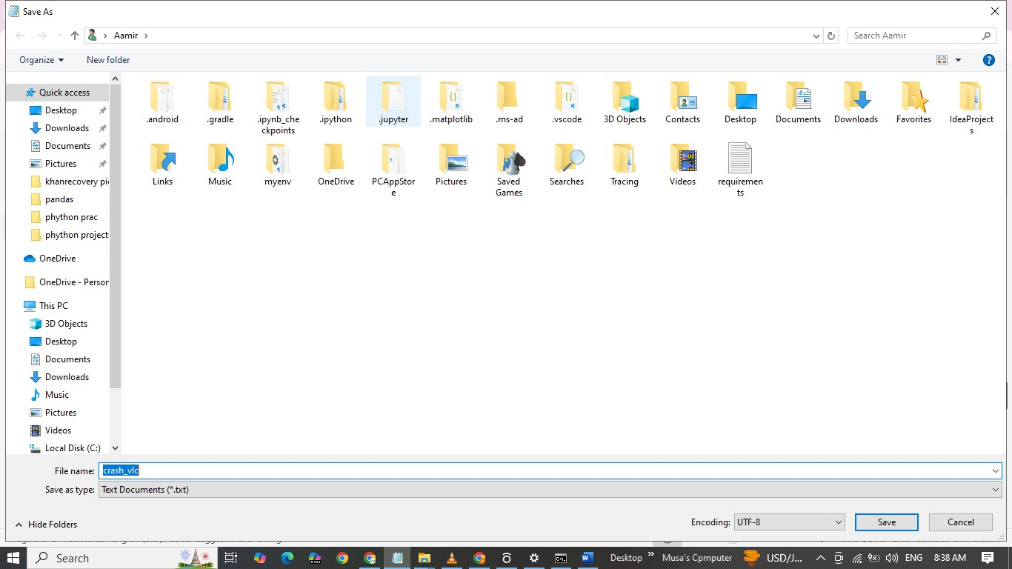

Slide 11
Step 2: Open the File in VLC
Launch VLC Media Player.
Open the newly created malicious.mkv file.
Observe if VLC crashes or behaves unexpectedly.

Slide 12
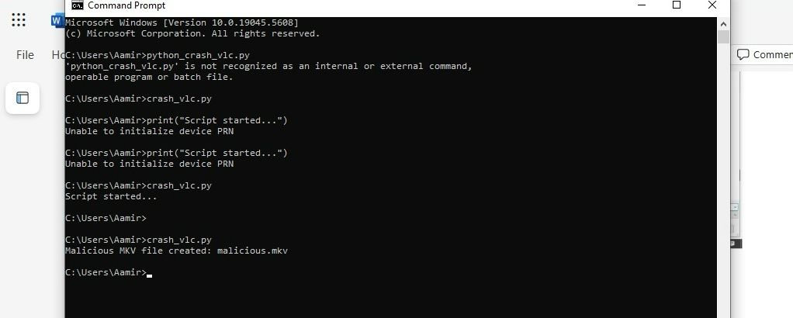

Slide 13
Step 3: Analyze Results
If VLC crashes, it indicates a successful exploit.
If VLC blocks the file, it may be patched or protected.
Check VLC logs for error messages and debugging information.

Slide 14
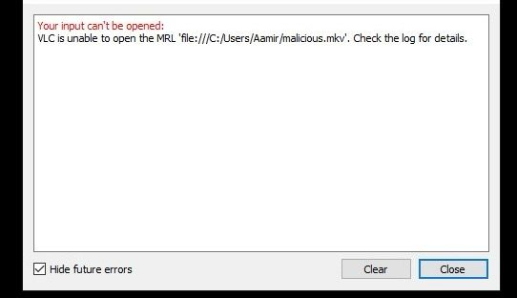

Slide 15
7. Mitigation Strategies
Regular Updates: Ensure VLC is updated to the latest version to patch security vulnerabilities.
Restrict Network Access: Disable VLC’s automatic network stream playback to avoid remote exploits.
Use Sandboxing: Run VLC in a virtualized or sandboxed environment to prevent system-wide attacks.
Disable Unnecessary Plugins: Reduce the attack surface by disabling unnecessary VLC features and plugins.

Slide 16
8. Conclusion & Recommendations
While VLC is a powerful media player, its vulnerabilities can pose significant security risks if left unpatched. Organizations should follow best security practices such as regular patching, restricting access, and implementing sandboxing to mitigate third-party risks.

Slide 17
References:
National Vulnerability Database (NVD): https://nvd.nist.gov
CVE Details: https://www.cvedetails.com
VLC Security Advisory: https://www.videolan.org/security/

